Slide 1
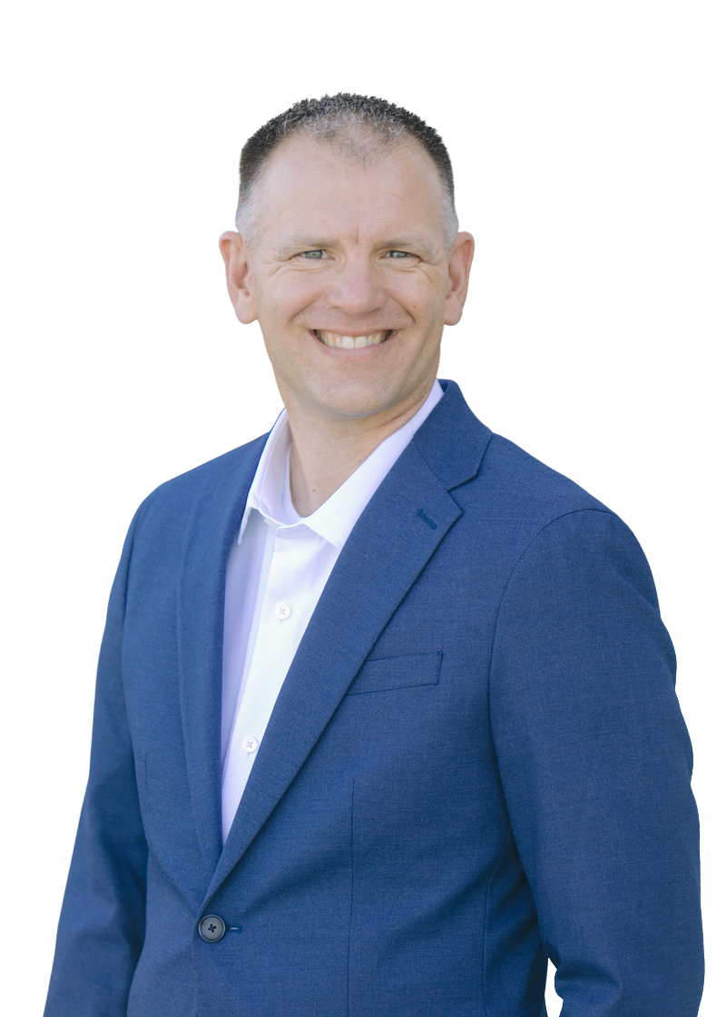
How the Cervical Spine Impacts the
Temporomandibular Joint
By Dr. Matthew Harkness DPT, MTC, CFC
Craniofacial Physical Therapist
Notes:
• I am Dr Matthew Harkness with certification head, neck and jaw
• Education
• Successes with treatment

Slide 2
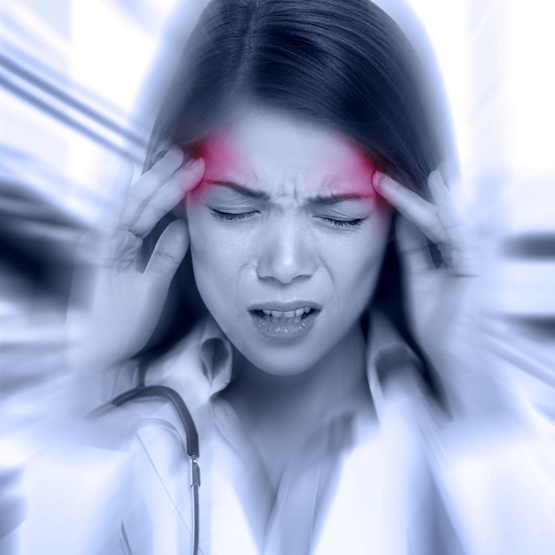

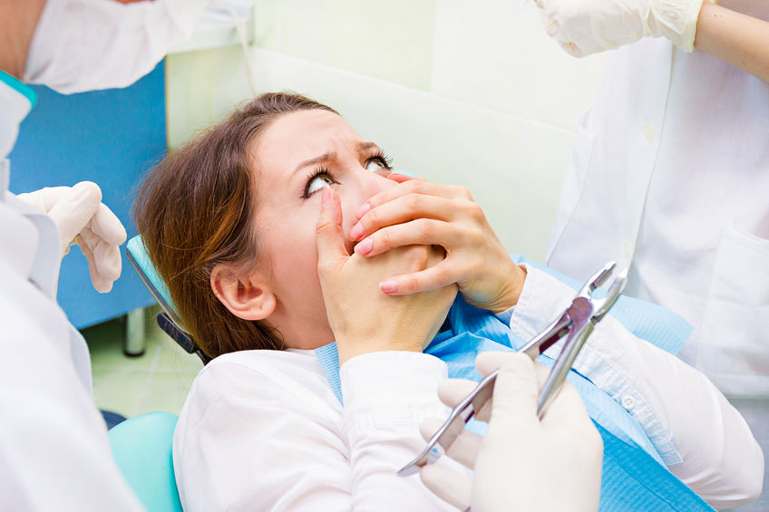


Are Your Patients:
Notes:
1. Unable to eat nutritious crunchy foods?
2. Unable to kiss and be intimate with their partner?
3. Complaining of vertigo/ headaches?
4. Fatigued, exhausted and unable to get rest?
5. Having difficulty tolerating dental treatment and procedures?

Slide 3
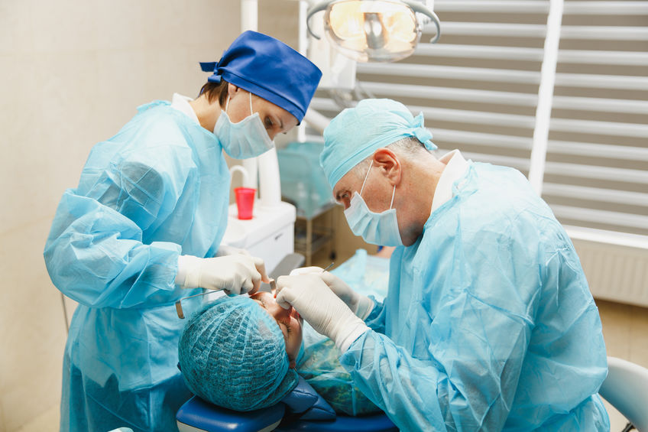





Causes of TMJ Pain
Notes:
Open Wide
Mouth breathing / Snoring
Biting nails
Electronics in bed
Trauma / car accident
Bad posture

Slide 4

Frustration
?
Notes:
When the pathology underlying craniofacial pain is unknown, there is nothing to “cure” and we will do best by focusing our treatments on what associated dysfunctions (mechanical, postural, and muscular)
Poor postural behavior habits
Sitting (unsupported)
Sleeping neck in end range position (stomach, too large of pillow)
Biting nails or cheek
Clenching
Gum chewing
Mechanical
Lack of mobility in joints (thoracic cervical, TMJ)
Hyper or hypomobility
Myofascial restriction
Muscular
Imbalance in flexibility
Weak
Hypertrophy excessive strength imbalance
Nerve
Hypersensitivity

Slide 5
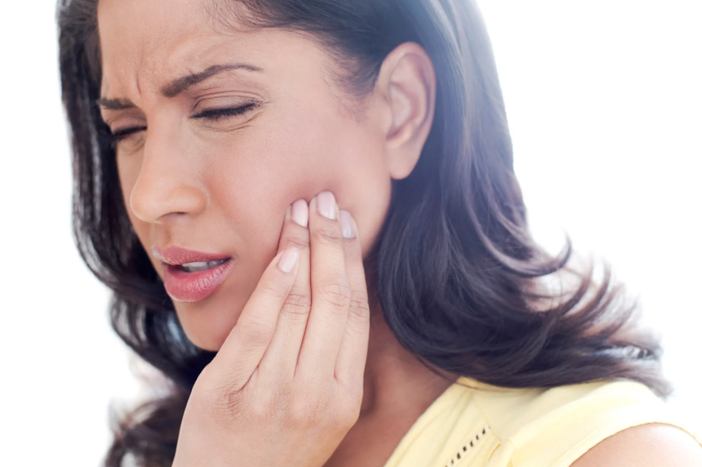
About the TMJ
The temporomandibular joint (TMJ) is undoubtedly one of the most actively used and least understood joints in the human body.

Slide 6
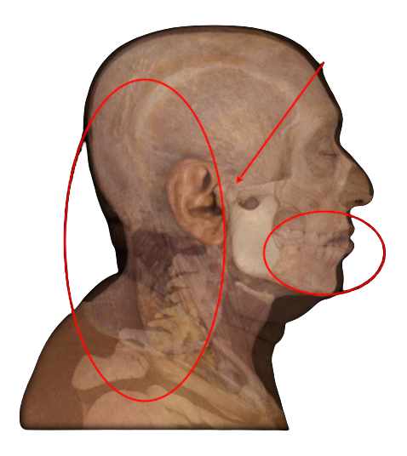
Cranio-Cervical-Mandibular Relationship
Cranio-Vertebral
Cranio-Mandibular

Slide 7
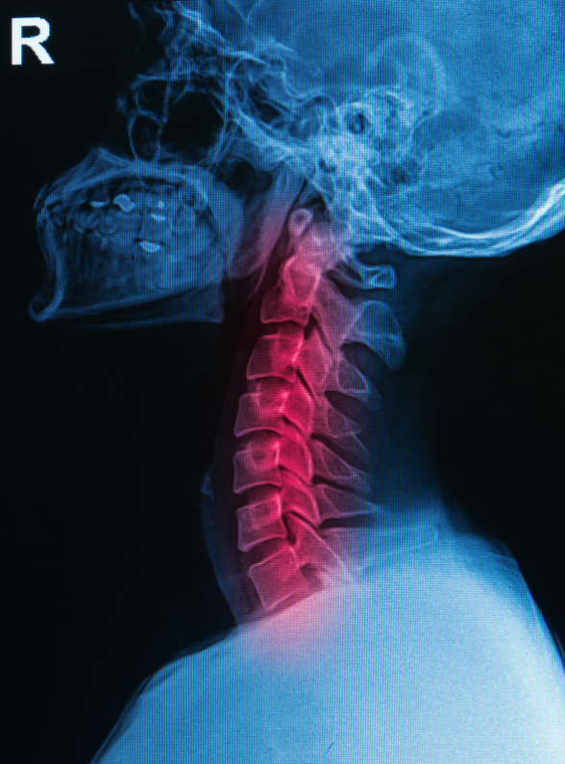
The Cervical Spine
The cervical spine is a missing piece in solving the TMJ puzzle

Slide 8
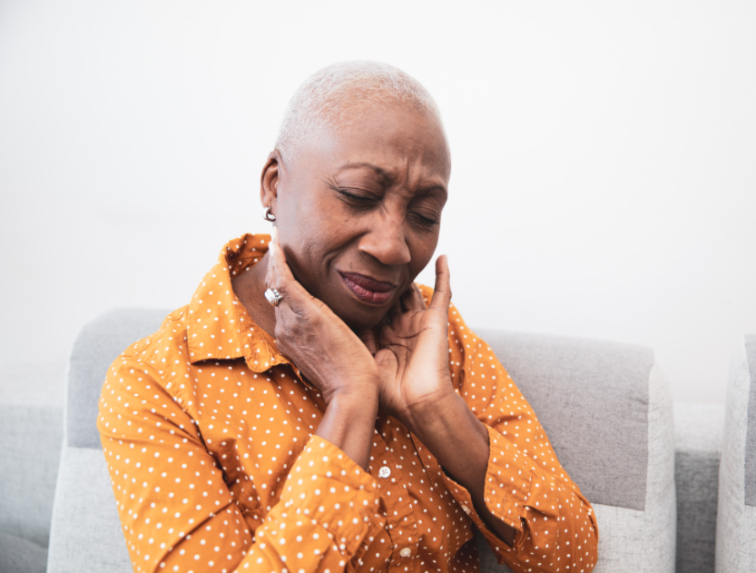
Characteristics of TMD
Neck pain was the second-most common symptom reported by 68% of TMD patients involved in a recent study*
Notes:
Characteristics of 511 patients with TMD referred for physical therapy.
The co-existence of neck pain and TMD has been reported previously and its clinical implications should not be underestimated.
By Stephen Kraus, PT: Oral Surg Oral Med Oral Pathol Oral Radiol 2014; 118:432-439

Slide 9
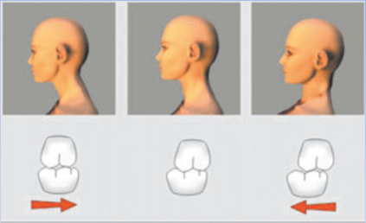
Interactions between Head and Mandibular Position*
Forward Head Posture
To Military
Mandibular Retrusion to Protrusion
Teeth contact more post to ant
Notes:
*Correlations between Posture and Jaw Relations, Danner, Jakstat and Ahlers, Journal of Craniomandibular Function, 2009; 1(2): 149-163

Slide 10
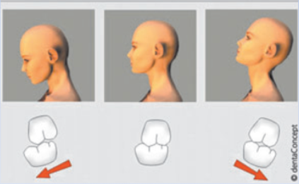
Interactions between Head and Mandibular Position*
Cervical Flexion to Cervical Extension
Mandibular Protrusion to Retrusion
Teeth contact more ant to post
Notes:
*Correlations between Posture and Jaw Relations, Danner, Jakstat and Ahlers, Journal of Craniomandibular Function, 2009; 1(2): 149-163

Slide 11

Head Immobilization can Impair Jaw Function*
Mandibular and head-neck movements were recorded to occur at the same time during rhythmic jaw activities in 12 healthy adults, with and without fixation of the head
Notes:
*Head immobilization can impair jaw function. Haggman-Henrikson B, Nordh E, Zafar H, Eriksson PO., J Dent Res., 2006 Nov; 85(11):1001-5

Slide 12
Head Immobilization can Impair Jaw Function*
The mandibular movements were significantly reduced in sessions with head fixation, opening reduced about 10mm
Notes:
*Head immobilization can impair jaw function. Haggman-Henrikson B, Nordh E, Zafar H, Eriksson PO., J Dent Res., 2006 Nov; 85(11):1001-5

Slide 13
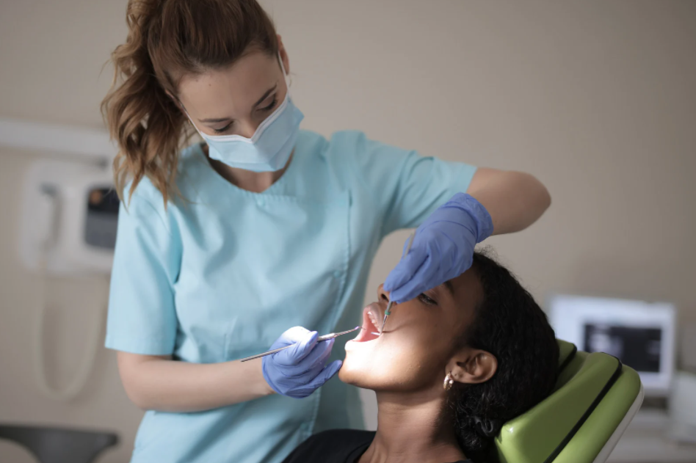

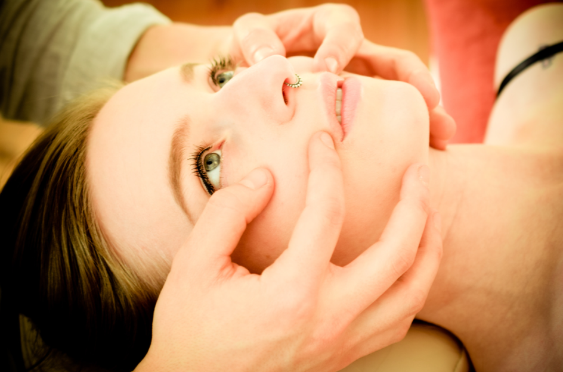
Bridging the Gap
Physical Therapy
Dentistry
TMD
Notes:
The intricacy of the temporomandibular joint (TMJ) and its relationship as to how it affects the harmony of the oral environment warrants analysis and understanding from an angle that many dentists are unaware of—physical therapy. What concepts are behind skilled TMJ therapy and what can this do for you, your patients, and your practice? We need to address the gap that exists between dentistry and therapy, and hopefully open the door to a service from which many patients and dentists can benefit.
Temporomandibular joint problems begin early in life even though the symptoms are not present until the adult years. Physical therapy in collaboration with dentistry provides an increasingly successful approach to longer lasting treatment. A correlation between Class II occlusion and forward head posture provides further evidence that the team approach is essential. Many TMJ headaches and referred pains of the neck and shoulders are caused by compression of the cervical joints. The proper orientation of four planes: the vertical plane, the bipupilar line, the plane of the otic system, and the occlusal plane are necessary for case success. Treatment involves the proper body mechanics, overcoming parafunctional oral habits, and instruction to restore mobility of the spine. The coordinated approach to treatment involves dental and medical professionals and physical therapists to intercept many serious conditions.

Slide 14

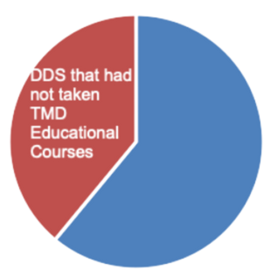
Increasing Dentists’ Awareness of PT
Nearly 40% of dentists responding to a survey reported never having taken continuing education courses on TMD.
Only 2.5% of 10,000 dentists surveyed responded to the inquiry.
Notes:
For those dentists reporting yes for taking courses on TMD, the courses included topics related to etiology and treatment of TMJ disorders; occlusion; bite plane therapy; TMD and occlusion; splint therapy, medication and restorative therapy; surgical and nonsurgical treatment; facial pain; myofascial pain and TMD; arthroscopic surgery, traumatic derangement; joint prosthetics and replacement; and occlusion and posture. Six dentists reported PT as part of the topic in the continuum education course taken.

Slide 15
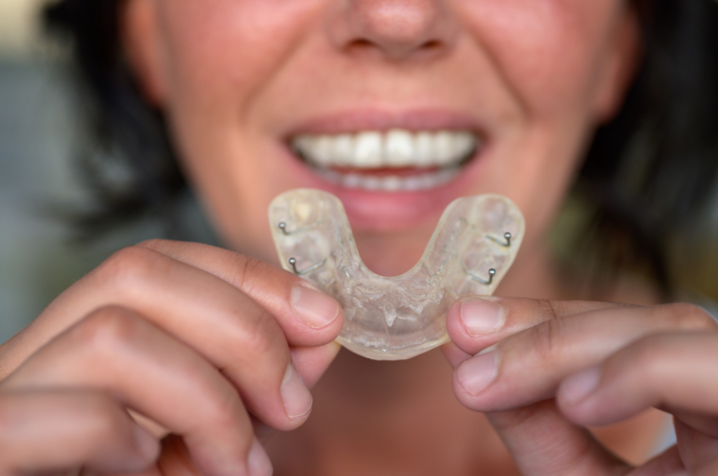
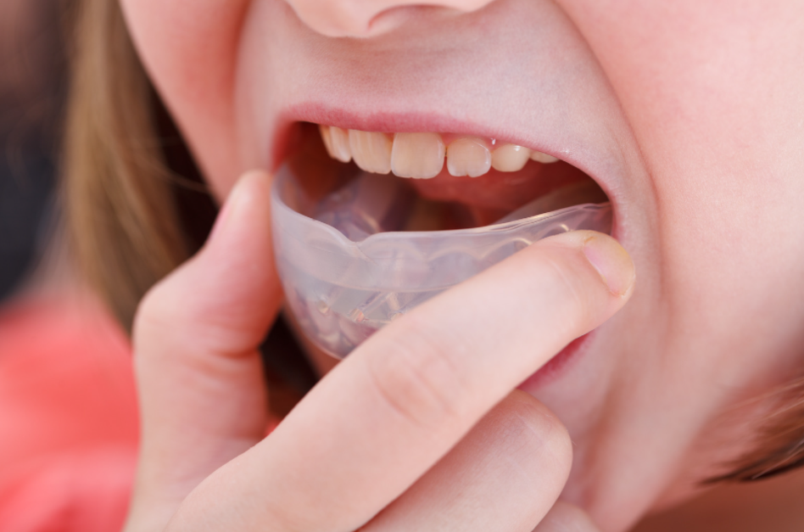

Dentist TMD Evaluation & Treatment
The most frequent methods used to treat TMD patients who were not referred:
Bite splints (90%)
Prescription meds (62%)
Occlusion correction (58%)
Notes:
Evaluation: When asking the dentists whether or not their TMD patients also presented with neck pain, poor posture, and/or cervicogenic headache:
Roughly 1 in 3 reported never evaluating these conditions, respectively.
From those who had evaluated, 3 out of 4 reported finding these conditions, respectively, present in their patients.

Slide 16

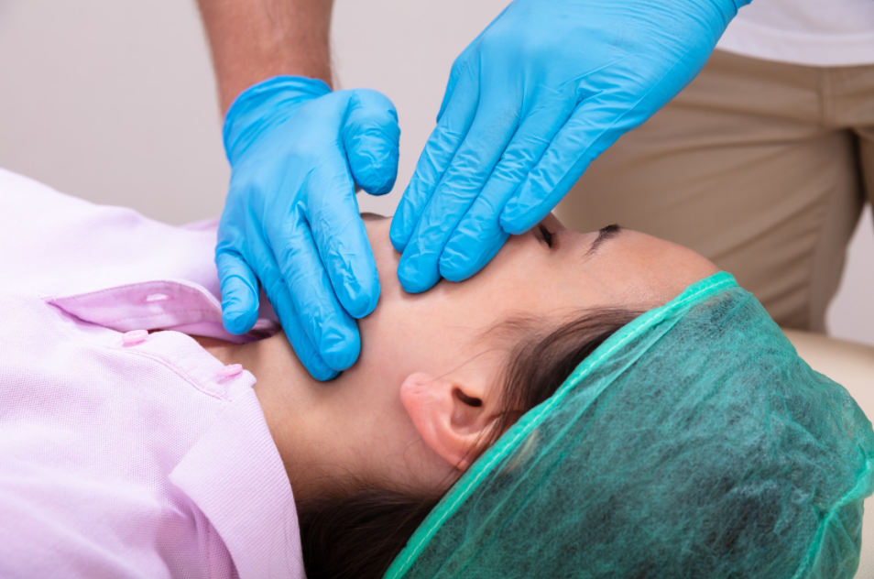
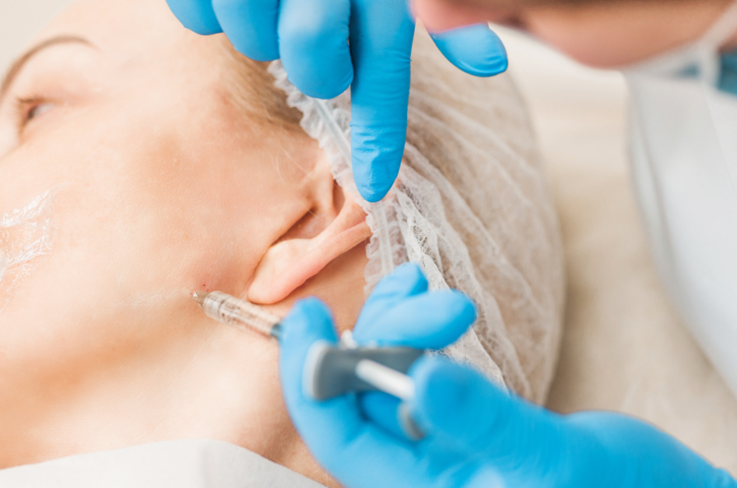
Dentist TMD Evaluation & Treatment
30% of dentists utilized other treatments:
Ice/Heat
Arthrocentesis
Diet alteration
Jaw and Neck Exercises
Botox
Trigger point injection
Thermotherapy and Cryotherapy
Soft Tissue Massage
86% referred TMD patients to other healthcare providers
Notes:
Evaluation: When asking the dentists whether or not their TMD patients also presented with neck pain, poor posture, and/or cervicogenic headache:
Roughly 1 in 3 reported never evaluating these conditions, respectively.
From those who had evaluated, 3 out of 4 reported finding these conditions, respectively, present in their patients.

Slide 17
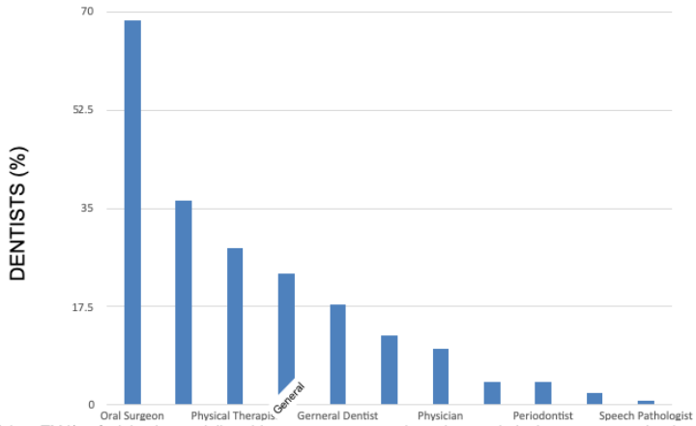
Dentist TMD Referrals
Dentists were
more likely to
refer TMD
patients to
oral surgeon
than to
physical therapist
Notes:
Other providers dentists were likely to refer to: TMJ/orofacial pain specialist, chiropractor, massage therapist, gnathologist, neuromuscular dentist, endocrinologist, neurologist, osteopath, and ENT

Slide 18

Why Dentists do not refer TMD Patients
Do not know what the process is to refer
None have offered services
Too specific of treatment for PT to be helpful
Insurance issues
Not allowed to refer
PT treatment only helps temporarily
Do not know where to refer in my area
Notes:
Information on the role of PT on TMD treatment should be part of seminars and lectures in the curriculum of Dentistry Programs to inform them on the importance of interdisciplinary treatment of TMD patients and Vice Versa.

Slide 19
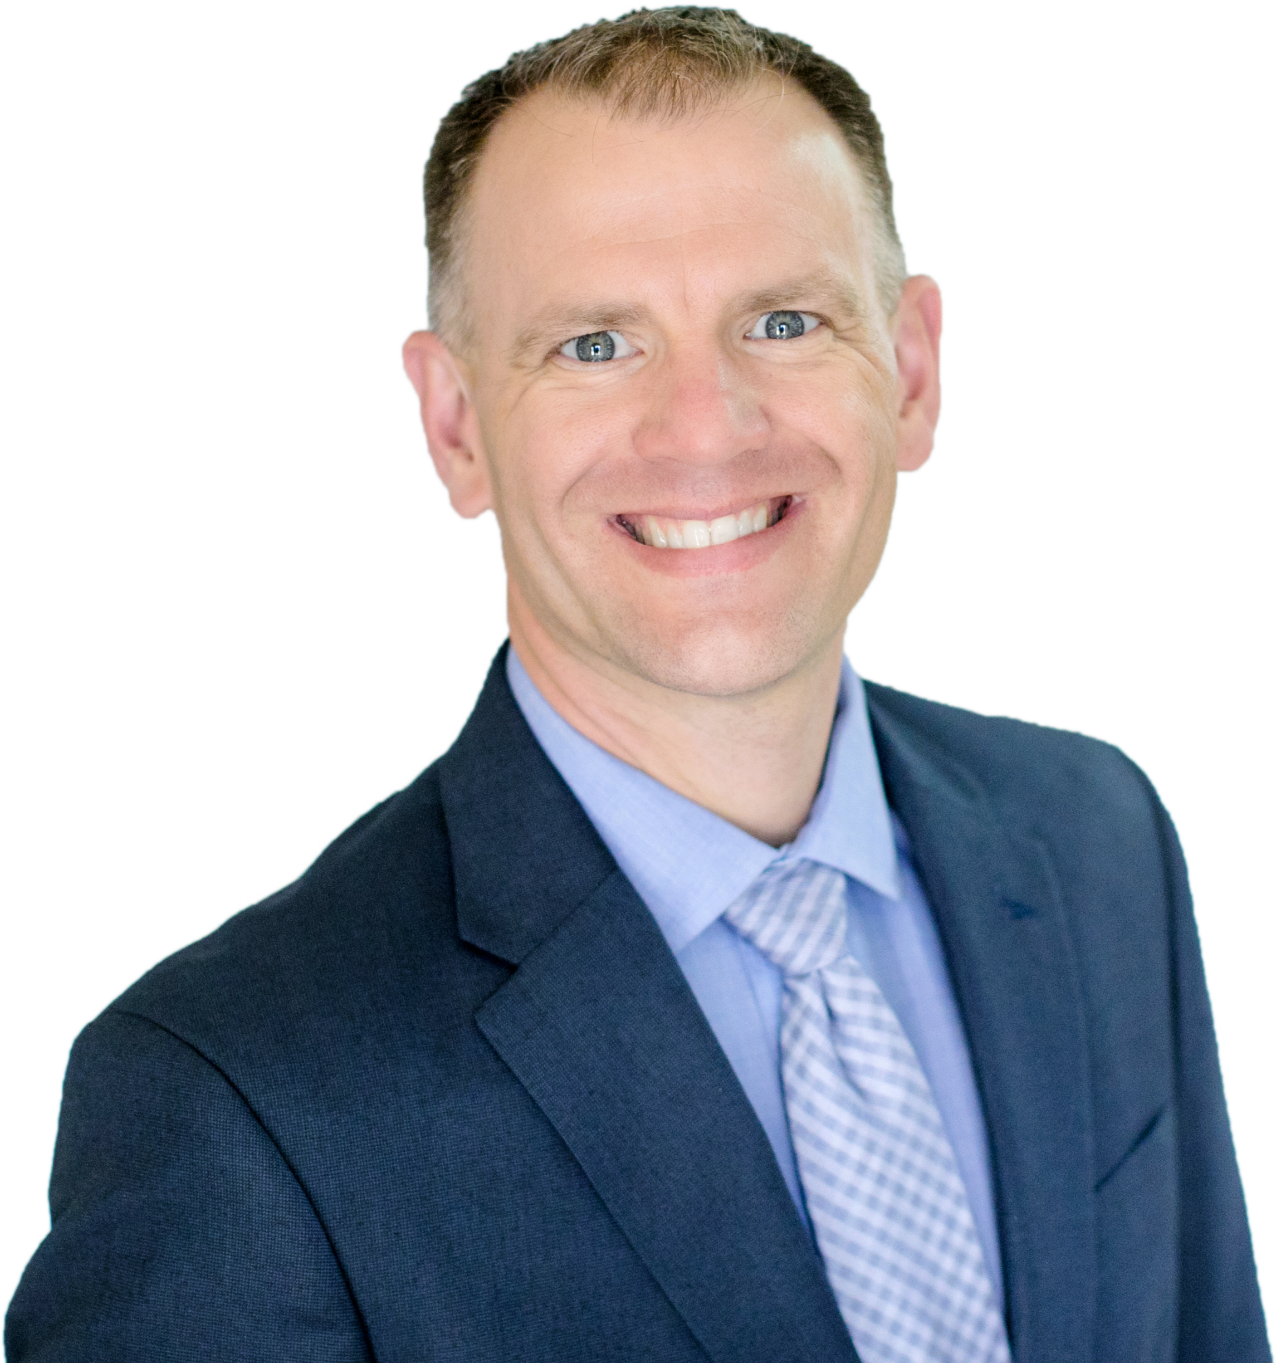

Partnership
Simple, Conservative Treatments that Work!
Let’s Work Together!
Notes:
At the end of the survey, 80% of the dentists (180) were interested to know more about the benefits of the collaborations with PTs to treat TMD patients.
Which can help further increase the level of collaboration between PTs and Dentists in the treatment of TMD.
I help you to deliver happier patients
TMD patients no longer afraid of dental procedures and cleanings
Building patient loyalty through trust

Slide 20
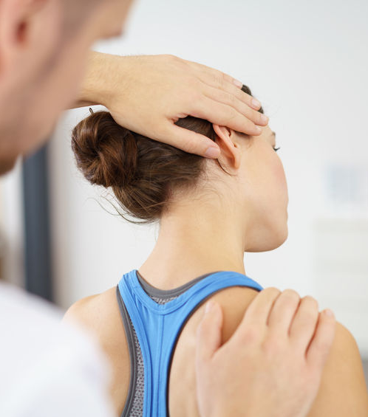
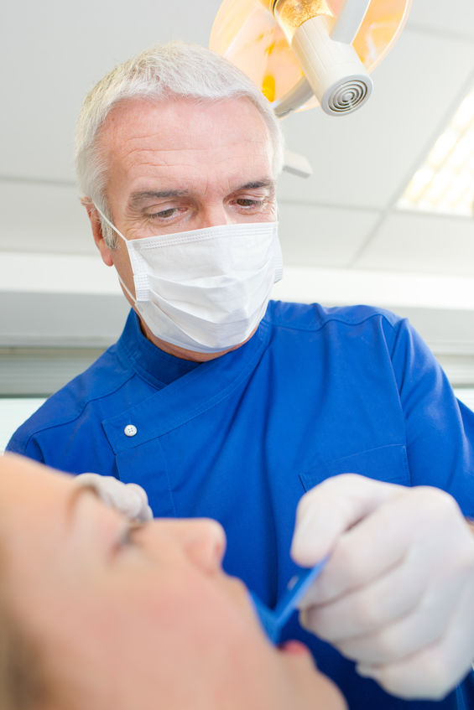
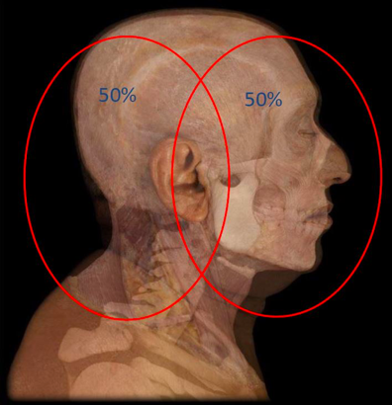
Working Together for Best Outcomes
Notes:
50/50 Craniofacial pain is frequently referred from the cervical spine.
TMJ is not always the main cause of a clinical problem. Pain can be caused by structures in and around the TMJ – or be referred from the cervical spine.
Working together with dental provider, providing treatment that will result in best outcome for the patient

Slide 21

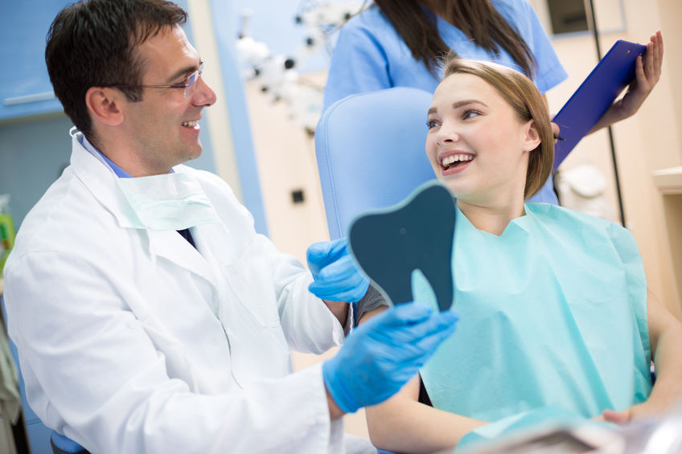


Happy Patients
Notes:
Patients experiencing pain while chewing can begin to eat healthy foods, and make better choices at the market, saving their health and their teeth.
Patients can once again smile, cheer and enjoy their families without fear of locking, clicking and pain.
After specialized therapy, TMD patients are less apprehensive about returning to the dentist chair, making necessary dental work possible.

Slide 22


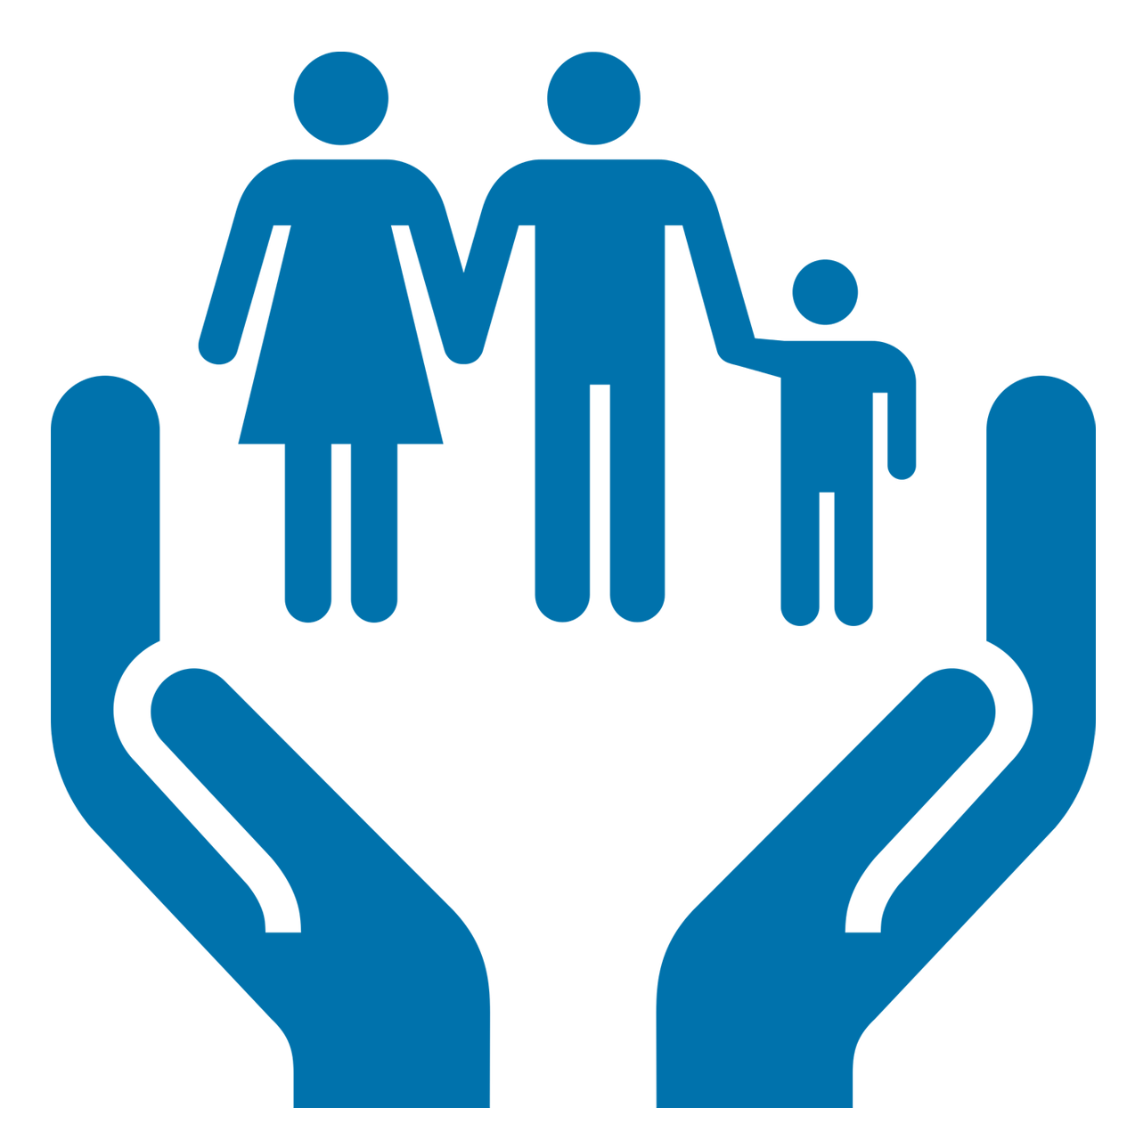

Just make Referral!
Send demographics and script – we do the rest!
1
We treat your patients like our own family
2
Happy patients get back
to what they love sooner!
3
Notes:
Get

Slide 23

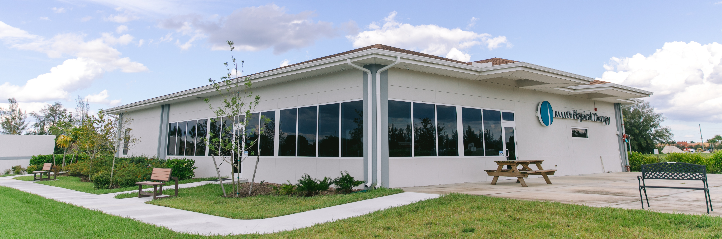

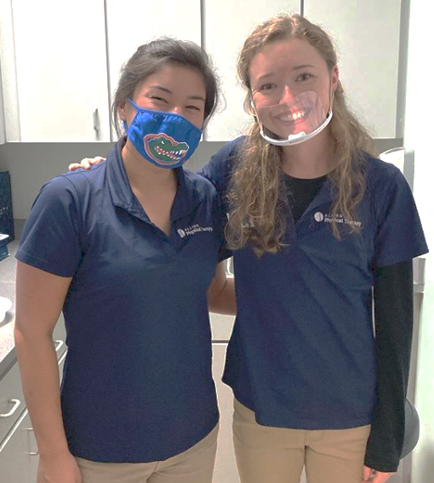
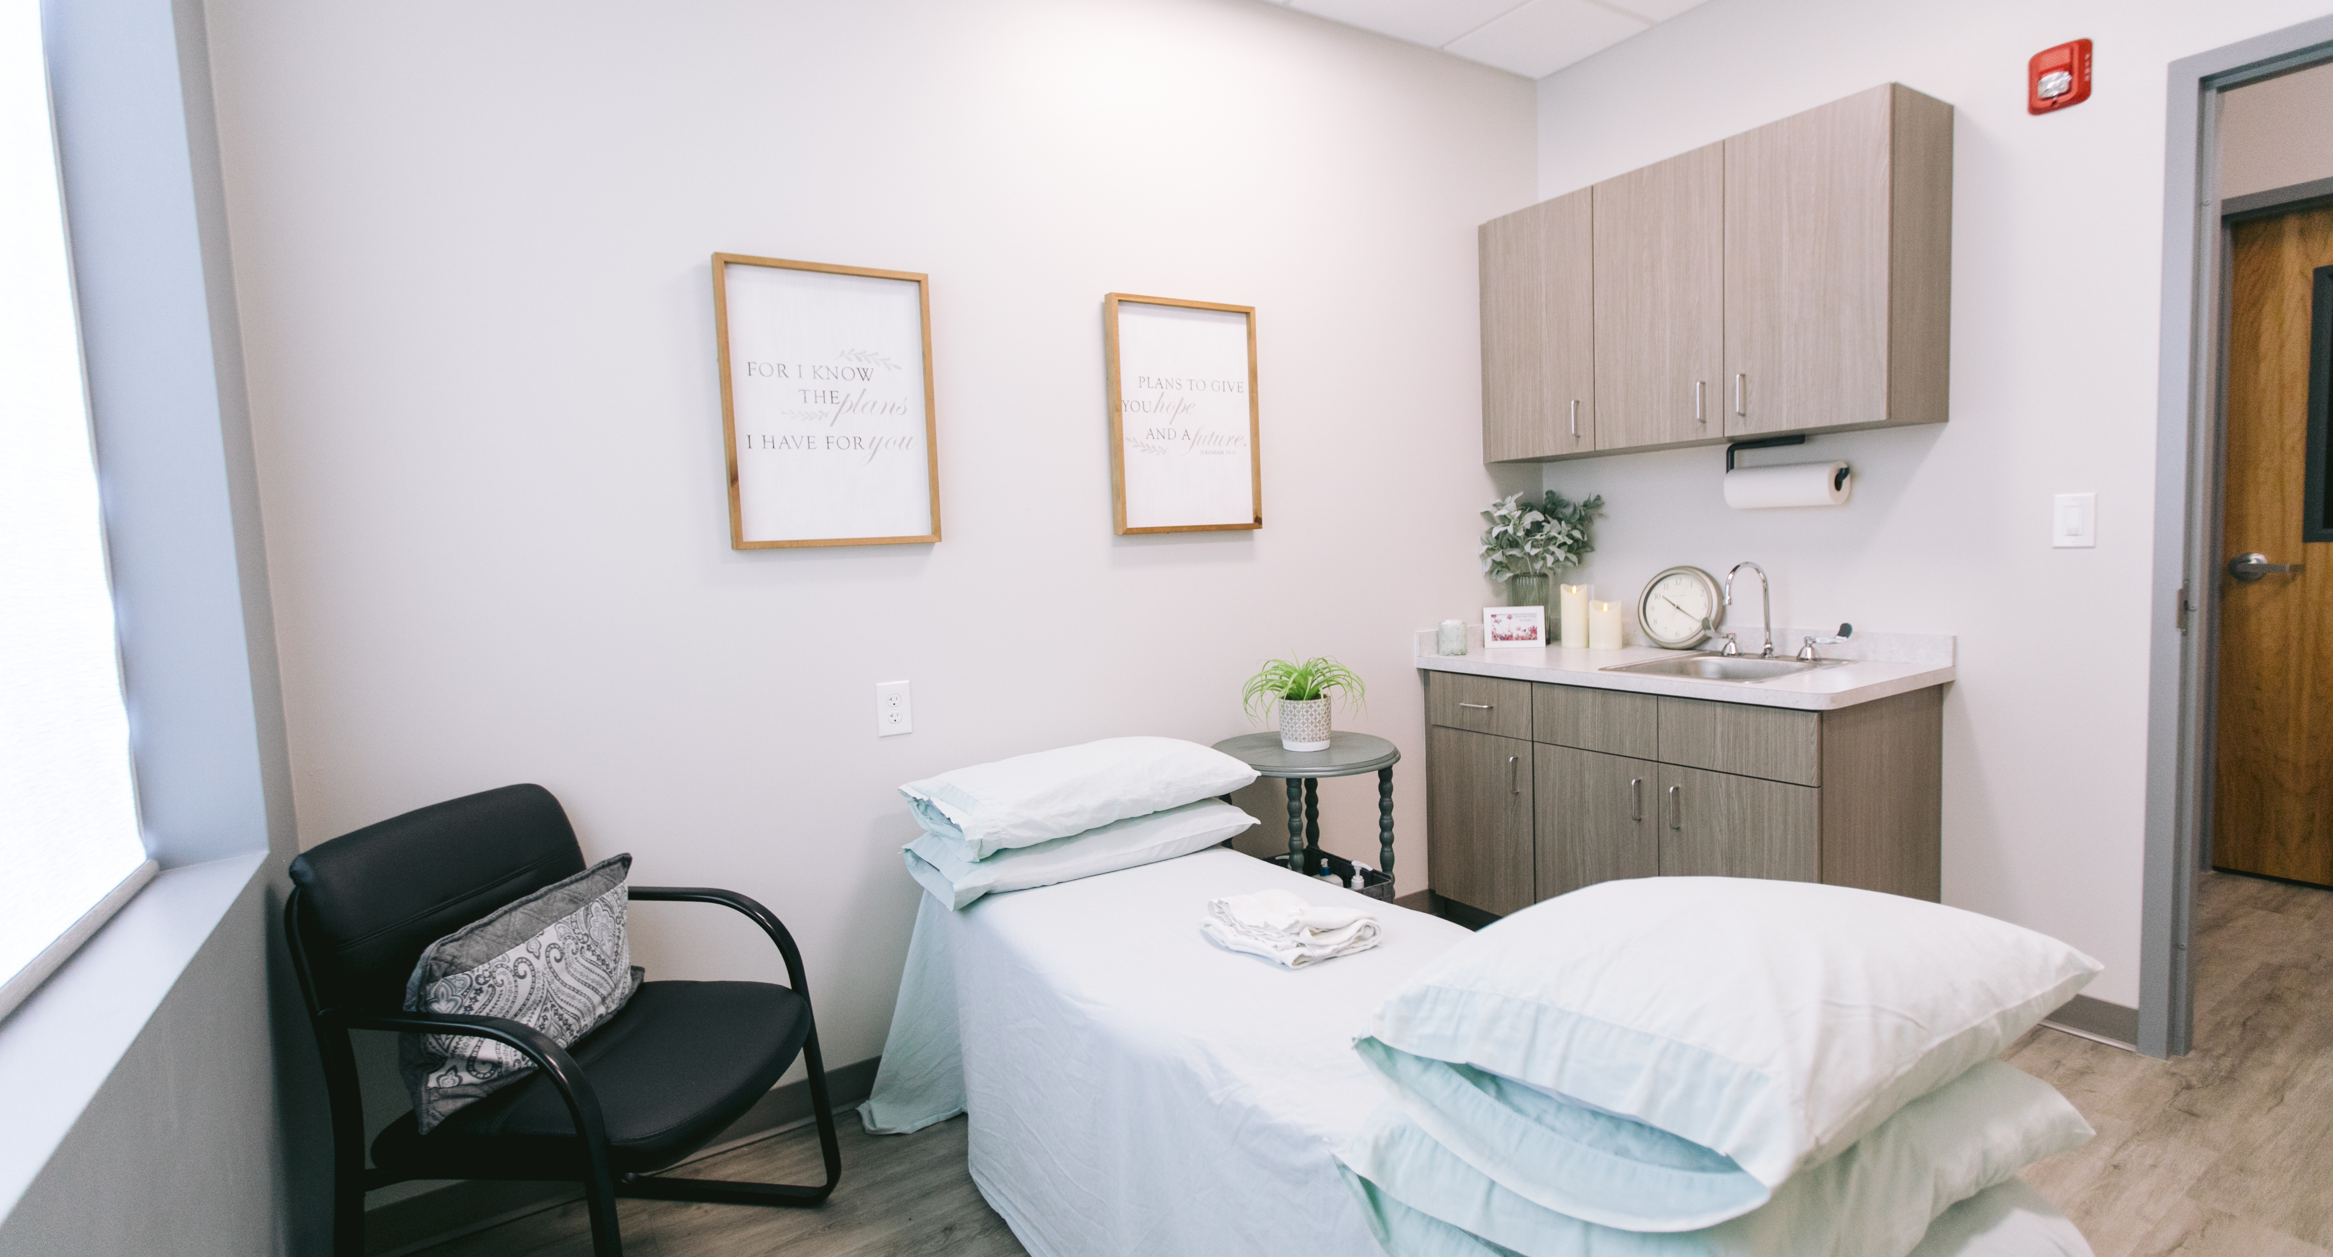
Our Family Experience
Notes:
• State of the art treatment facility, with updated equipment, family atmosphere.
• Safety precautions
• 15 years in Cape Coral
• Family-owned
• Second-mile service

